Slide 1
Chapter -3
Event Handling

Slide 2
What is EVENT?

Slide 3
Event are the change in the state of the object.
Types of Event
  Foreground Events:
    Those events which require the direct interaction of user.
    They are generated as consequences of a person interacting with the graphical components ni Graphical User Interface.
    For example, clicking on abuton, moving the mouse, entering a character through keyboard, selecting an item from list, scrolling the page etc.
  Background Events:
    Those events that do not require the interaction of end user are known as background events.
    Operating system interrupts, hardware or software failure, timer expires, an operation completion are the example of background events.

Slide 4
Two event handling mechanisms
1.0 Model
The delegation event model

Slide 5
The way in which events are handled changed significantly between the original version of Java (1.0) and all subsequent versions of Java, beginning with version 1.1.
Although the 1.0 method of event handling is still supported, it is not recommended for new programs.
Also, many of the methods that support the old 1.0 event model have been deprecated.

Slide 6
1.0 Event Model
An event was propagated up the containment hierarchy until it was handled by a component.
Upon receiving a user-initiated event, like a mouse click, the system generates an instance of the Event class and passes it along to the program. The program identifies the event's target (i.e., the component in which the event occurred) and asks that component to handle the event. If the target can't handle this event, an attempt is made to find a component that can, and the process repeats.
This required components to receive events that they did not process, and it wasted valuable time. The delegation event model eliminates this overhead.

Slide 7
The delegation event model
The modern approach to handling events is based on the delegation event model, which defines standard and consistent mechanisms to generate and process events.
Its concept is quite simple: a source generates an event and sends it to one or more listeners.
In this scheme, the listener simply waits until it receives an event. Once an event is received, the listener processes the event and then returns.
The advantage of this design is that the application logic that processes events is cleanly separated from the user interface logic that generates those events.
A user interface element is able to “delegate” the processing of an event to a separate piece of code.

Slide 8
In the delegation event model, listeners must register with a source in order to receive an event notification.
This provides an important benefit: notifications are sent only to listeners that want to receive them.

Slide 9
Events
In the delegation model, an event is an object that describes a state change in a source.
Among other causes, an event can be generated as a consequence of a person interacting with the elements in a graphical user interface.
Some of the activities that cause events to be generated are pressing a button, entering a character via the keyboard, selecting an item in a list, and clicking the mouse.
Many other user operations could also be cited as examples. Events may also occur that are not directly caused by interactions with a user interface.
For example, an event may be generated when a timer expires, a counter exceeds a value, software or hardware failure occurs, or an operation is completed. You are free to define events that are appropriate for your application.

Slide 10
Event Sources
A source is an object that generates an event. This occurs when the internal state of that object changes in some way.
Sources may generate more than one type of event. A source must register listeners in order for the listeners to receive notifications about a specific type of event.
Each type of event has its own registration method.
Here is the general form:
public void addTypeListener (TypeListener eL )
Here, Type is the name of the event, and eL is a reference to the event listener.
For example, the method that registers a keyboard event listener is called addKeyListener( ).
The method that registers a mouse motion listener is called addMouseMotionListener( ).

Slide 11
Some sources may allow more than one listener to register.
When an event occurs, all registered listeners are notified and receive a copy of the event object. This is known as multicasting the event.
In all cases, notifications are sent only to listeners that register to receive them.
Some sources may allow only one listener to register. When such an event occurs, the registered listener is notified. This is known as unicasting the event.

Slide 12
A source must also provide a method that allows a listener to unregister an interest in a specific type of event. The general form of such method is :
public void removeTypeListener(TypeListener el )
Here, Type is the name of the event, and el is a reference to the event listener.
For example, to remove a keyboard listener, you would call removeKeyListener( ).
The methods that add or remove listeners are provided by the source that generates events.
For example, the Component class provides methods to add and remove keyboard and mouse event listeners.

Slide 13
Event Classes
The classes that represent events are at the core of Java’s event handling mechanism.
Thus, a discussion of event handling must begin with the event classes.
It is important to understand, however, that Java defines several types of events and that not all event classes can be discussed in this chapter.
Arguably, the most widely used events at the time of this writing are those defined by the AWT and those defined by Swing.

Slide 14
The KeyEvent Class
A KeyEvent is generated when keyboard input occurs.
KeyEvent is a subclass of InputEvent.
There are three types of key events, which are identified by these integer constants:
KEY_PRESSED, KEY_RELEASED, and KEY_TYPED.
The first two events are generated when any key is pressed or released.
The last event occurs only when a character is generated.
Remember, not all key presses result in characters. For example, pressing shift does not generate a character.

Slide 15
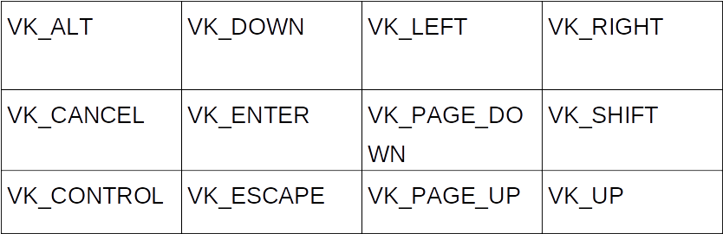
There are many other integer constants that are defined by KeyEvent.
For example, VK_0 through VK_9 and VK_A through VK_Z define the ASCII equivalents of the numbers and letters.
The VK constants specify virtual key codes

Slide 16
The MouseEvent Class
This event indicates a mouse action occurred in a component.
MouseEvent is a subclass of InputEvent.
There are eight types of mouse events. The MouseEvent class defines the following integer constants that can be used to identify them.

Slide 17
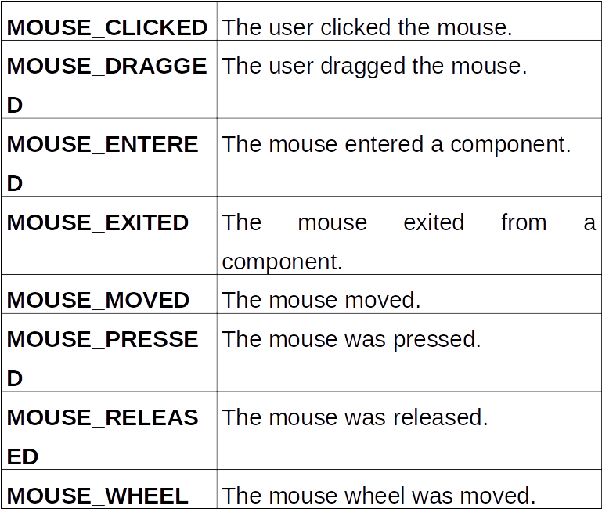

Slide 18
Two commonly used methods in this class are getX( ) and getY( ).
These return the X and Y coordinates of the mouse within the component when the event occurred.
Their forms are shown here:
int getX( )
int getY( )
Alternatively, you can use the getPoint( ) method to obtain the coordinates of the mouse. It is shown here:
Point getPoint( )
It returns a Point object that contains the X,Y coordinates in its integer members: x and y.

Slide 19
WindowEvent Class
The object of this class represents the change in state of a window.
This low-level event is generated by a Window object when it is :
  Opened
  Closed
  Activated
  Deactivated
  Focus is transferred into or out of the Window.
Some Window events are:

Slide 20
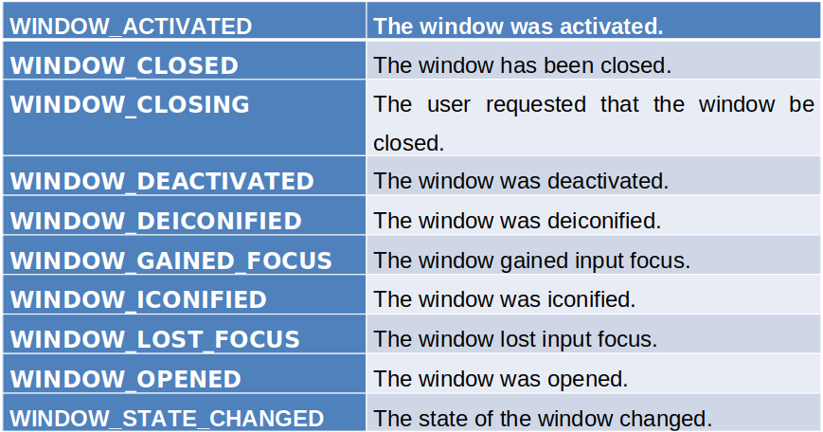

Slide 21
Action Event
The Action Event is generated when button is clicked or the item of a list is double-clicked.
The listener related to this class is ActionListener.
To handle an action event, a class must implements the Action Listener interface.
To have any component listen for an ActionEvent, we must register the component with an ActionListener

Slide 22
Event Listeners
A listener is an object that is notified when an event occurs. It has two major requirements.
First, it must have been registered with one or more sources to receive notifications about specific types of events.
Second, it must implement methods to receive and process these notifications.
The methods that receive and process events are defined in a set of interfaces, such as those found in java.awt.event.

Slide 23
Event Listener Interfaces
As explained, the delegation event model has two parts: sources and listeners.
Listeners are created by implementing one or more of the interfaces defined by the java.awt.event package.
When an event occurs, the event source invokes the appropriate method defined by the listener and provides an event object as its argument.
Table below lists several commonly used listener interfaces and provides a brief description of the methods that they define.
The following sections examine the specific methods that are contained in each interface.

Slide 24
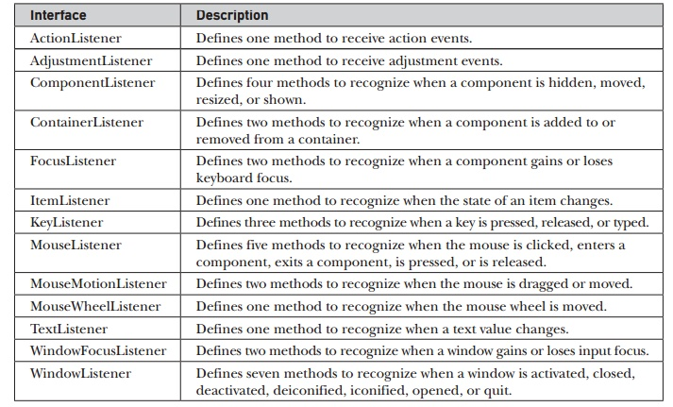

Slide 25
The ActionListener Interface
The Java ActionListener is notified whenever you click on the button or menu item.
It is notified against ActionEvent.
The ActionListener interface is found in java.awt.event package.
It has only one method: actionPerformed(). It is invoked when an action event occurs. Its general form is shown here:
void actionPerformed(ActionEvent ae)

Slide 26
The KeyListener Interface
The Java KeyListener is notified whenever you change the state of key.
It is notified against KeyEvent.
The KeyListener interface is found in java.awt.event package. It has three methods.
  void keyPressed(KeyEvent ke)
  void keyReleased(KeyEvent ke)
  void keyTyped(KeyEvent ke)
Example: if a user presses and releases the a key, three events are generated in sequence: key pressed, typed, and released.
If a user presses and releases the home key, two key events are generated in sequence: key pressed and released.

Slide 28
The MouseListener Interface
The Java MouseListener is notified whenever you change the state of mouse.
It is notified against MouseEvent.
The MouseListener interface is found in java.awt.event package.
It has five methods:
  void mouseClicked(MouseEvent me)
  void mouseEntered(MouseEvent me)
  void mouseExited(MouseEvent me)
  void mousePressed(MouseEvent me)
  void mouseReleased(MouseEvent me)
If the mouse is pressed and released at the same point, mouseClicked( ) is invoked.
When the mouse enters a component, the mouseEntered( ) method is called.
When it leaves, mouseExited( ) is called.
The mousePressed( ) and mouseReleased( ) methods are invoked when the mouse is pressed and released, respectively.

Slide 29
The WindowListener Interface
The Java WindowListener is notified whenever you change the state of window.
It is notified against WindowEvent.
The WindowListener interface is found in java.awt.event package.
This interface defines seven methods:
  void windowActivated(WindowEvent we)
  void windowClosed(WindowEvent we)
  void windowClosing(WindowEvent we)
  void windowDeactivated(WindowEvent we)
  void windowDeiconified(WindowEvent we)
  void windowIconified(WindowEvent we)
  void windowOpened(WindowEvent we)

Slide 30
Adapter Class
Java provides a special feature, called an adapter class, that can simplify the creation of event handlers in certain situations.
An adapter class provides an empty implementation of all methods in an event listener interface.
Adapter classes are useful when you want to receive and process only some of the events that are handled by a particular event listener interface.
You can define a new class to act as an event listener by extending one of the adapter classes and implementing only those events in which you are interested.
For example, the MouseMotionAdapter class has two methods, mouseDragged( ) and mouseMoved( ), which are the methods defined by the MouseMotionListener interface. If you were interested in only mouse drag events, then you could simply extend MouseMotionAdapter and override mouseDragged( ). The empty implementation of mouseMoved( ) would handle the mouse motion events for you.

Slide 31
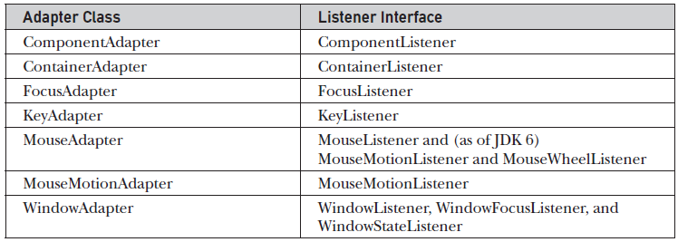

Slide 32
Event Handling Approach
The three approaches for performing event handling are by placing the event handling code in one of the below-specified places.
Within Class
Other Class
Anonymous Class

